Slide 1
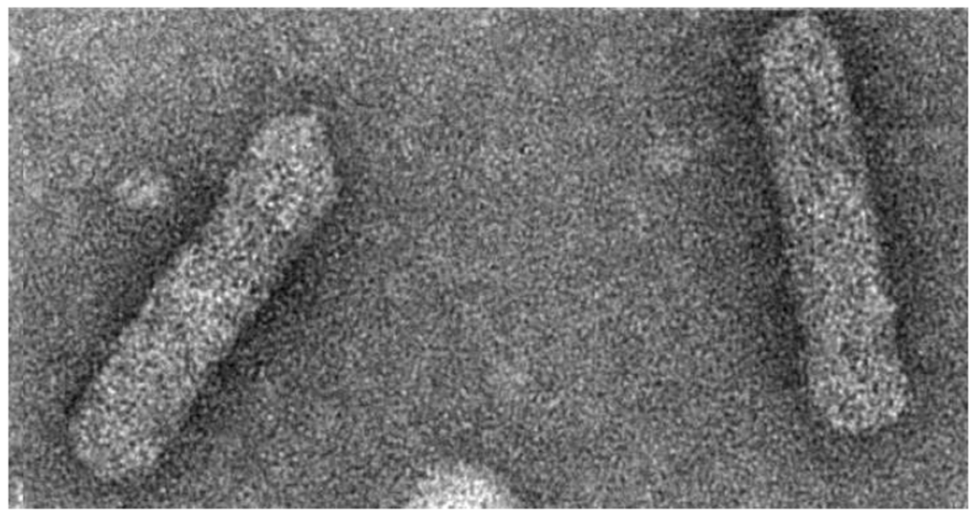
Banana Streak Viruses Badnaviruses

Slide 2
Taxonomy, phylogeny, etc.

Slide 3
Caulimoviridae (family)
https://www.nature.com/articles/s41598-017-16399-x

Slide 4
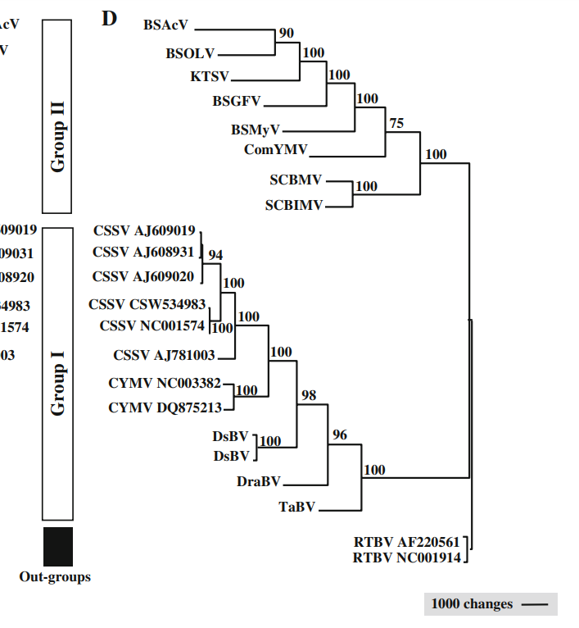
Badnavirus (genus)
Phylogenetic tree based on whole genome sequences
https://link.springer.com/article/10.1007/s00705-008-0095-9

Slide 5
Badnaviruses are host-specific
What is similar about these hosts?
Banana
Sugarcane
Cacao
Citrus
Taro
https://link.springer.com/article/10.1007/s00705-008-0095-9

Slide 6
Disease Biology, Ecology, Epidemiology

Slide 7
Banana Streak Disease
Warm (28-35°C)
Cool (22°C)

Slide 8
Banana Streak virus
Cucumber mosaic virus
(widest host range virus) Bromoviridae
plants should be grown under cool or fluctuating temperatures. The leaves should be inspected for chlorotic or necrotic streak or fleck symptoms. Not all leaves may show symptoms; often streaks are only seen on one or two leaves on an infected plant. Incomplete bunch emergence or bunches emerging through the pseudostem also suggest that the plant may be virus infected.
narrow, discontinuous chlorotic, and/or necrotic streaks that run parallel to the veins of the leaf lamina, and pseudostem splitting. In a few cases, internal necrosis, aberrant bunch emergence, fruit peel splitting, and necrotic fruit spots are also seen.
Symptoms and virus load depend strongly on temperature. Enhanced symptom expression was seen when plants were continuously grown at 22 °C, but became indiscernible when plants were shifted to continuous growth at 28 °C to 35 °C.

Slide 9
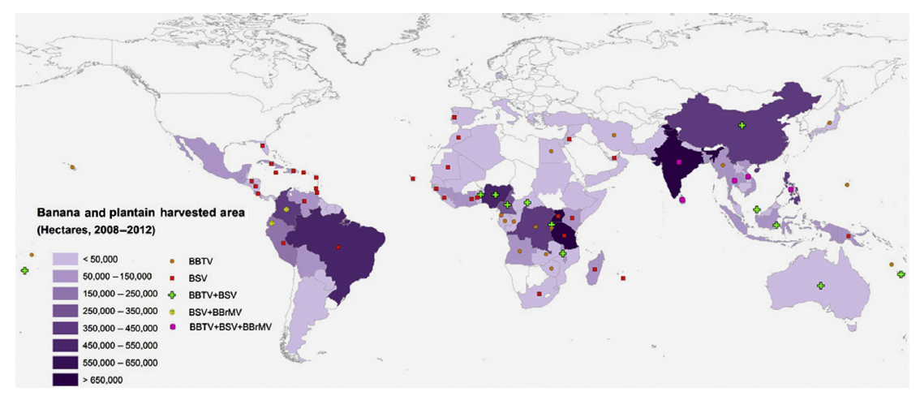
About 85% of this global production comes from small plots and backyard gardens in the developing world, and only 15% goes to the export trade.

Slide 10
Evolutionary history of Banana/Plantain
Common Musa ancestor
Speciation
(4, 6 MYA)
M. acuminata
M. balbisiana
Diversification
Wild Banana: Diploids
( chromosomes)
Domestication
7,000 YA
Interspecific Hybrids
chromosomes
AAA
AAB
ABB
Today
AA
AAAA
AAAB
AABB
BB
Dessert (free sugars) vs cooking banana (starchy)

Slide 11
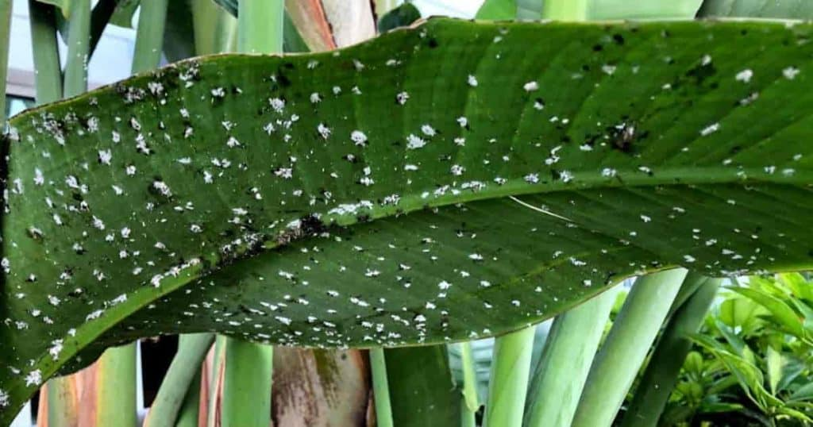
Evolution of BSV complex
Badnavirus ancestor
Musa ancestor
Outcomes:
BSV clade 2:
integrated but pseudogenized
BSV clade 2
AA
BB
AAA
AAB
ABB
AA
AAAA
AAAB
AABB
BB
Outcomes:
BSV clade 2: pseudogenized
Inactive

Slide 12
Evolution of BSV complex
Badnavirus ancestor
Musa ancestor
Outcomes:
BSV clade 1:
Integrated and
BSV clade 1
AA
BB
AAA
AAB
ABB
AA
AAAA
AAAB
AABB
BB
Outcomes:
BSV clade 2: pseudogenized
Inactive

Slide 13
Evolution of BSV complex
Badnavirus ancestor
Musa ancestor
Outcomes:
BSV clade 3:
Episomal; only insect transmitted
BSV clade 3
AA
BB
AAA
AAB
ABB
AA
AAAA
AAAB
AABB
BB
Outcomes:
BSV clade 2: pseudogenized
Inactive

Slide 14
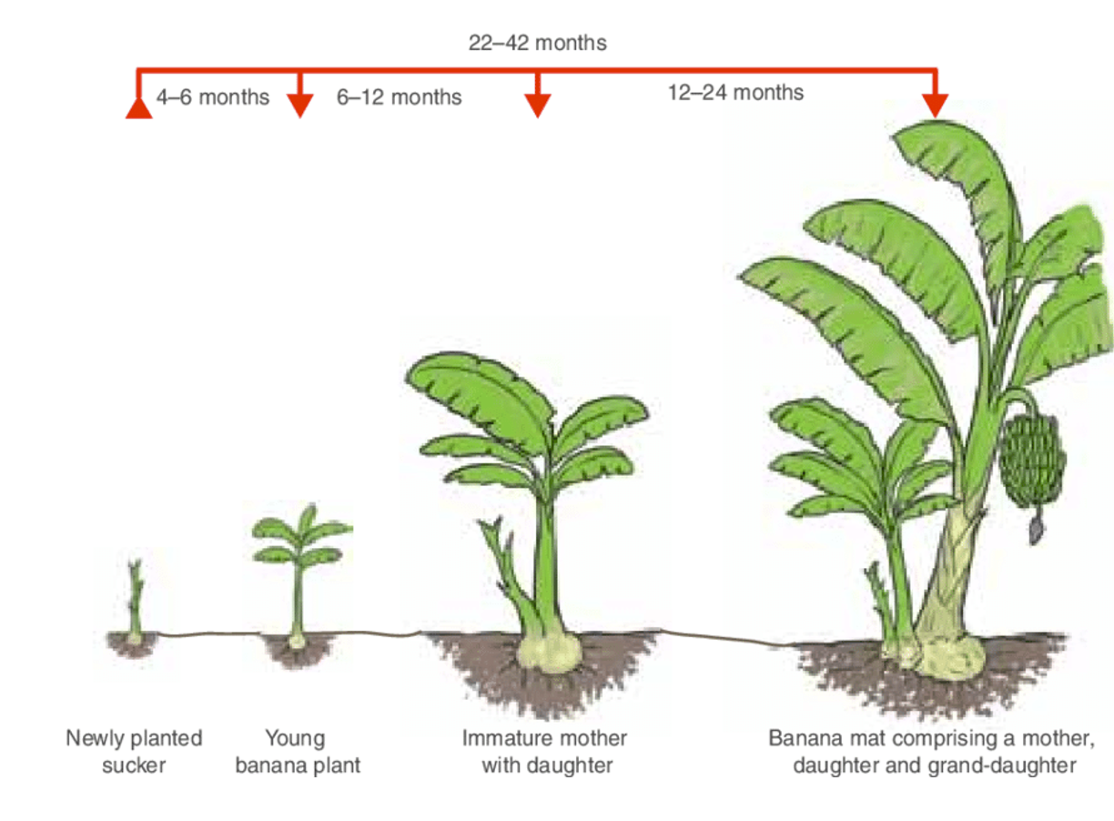
Transmission: endogenous BSV

Slide 15
Transmission: Episomal BSV

Slide 16
Structure: Virions & Genome

Slide 17
120–150 × 30 nm

Slide 18
ORF=Open Reading Frame
= 1 segment
= extrachromosomal,
closed circular DNA molecules
https://www.sciencedirect.com/science/article/pii/S187962571300148X

Slide 19
What Protein Functions are encoded on the BSOLV genome?
ORF3
ORF1
ORF2

Slide 20
Virion life cycle

Slide 21
Endocytosis?

Slide 23
RT-RH polymerase
RNaseH cannot degrade

Slide 24
https://www.sciencedirect.com/science/article/pii/S187962571300148X

Slide 25
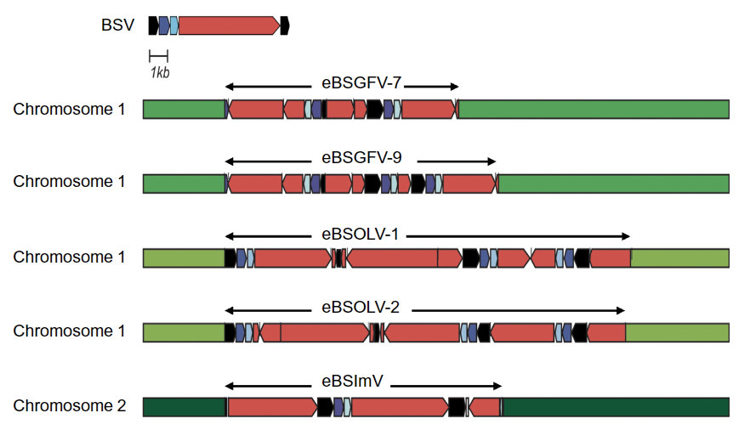
Integration into host genome

Slide 26
eBSV Silver linings

Slide 27
Please read the paper’s title.
Is any jargon unclear?
https://twitter.com/leena_tripathi

Slide 28
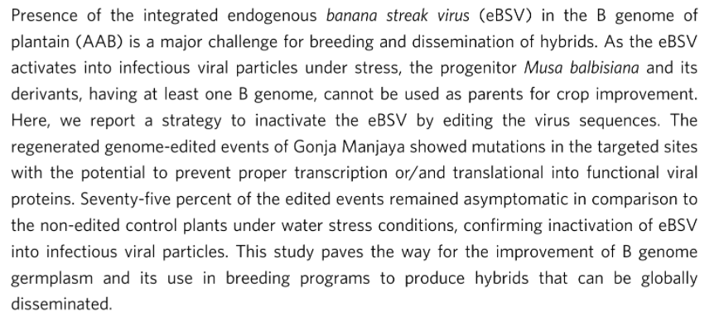
Please read the paper’s abstract
Is any jargon unclear?

Slide 29
BSOLV = Banana Streak Obino l’Ewai Virus
AAB Plantain cultivar from Nigeria.
one of the main cultivars used as a female parent plant in the banana breeding programme of IITA

Slide 30
CRISPR/Cas: An adaptive
Repeats
(CRISPR)
“spacers”
________: clustered regularly interspaced short palindromic repeats
____: CRISPR-associated (proteins)
Notes:
https://www.science.org/doi/full/10.1126/science.aat5011#F1

Slide 31
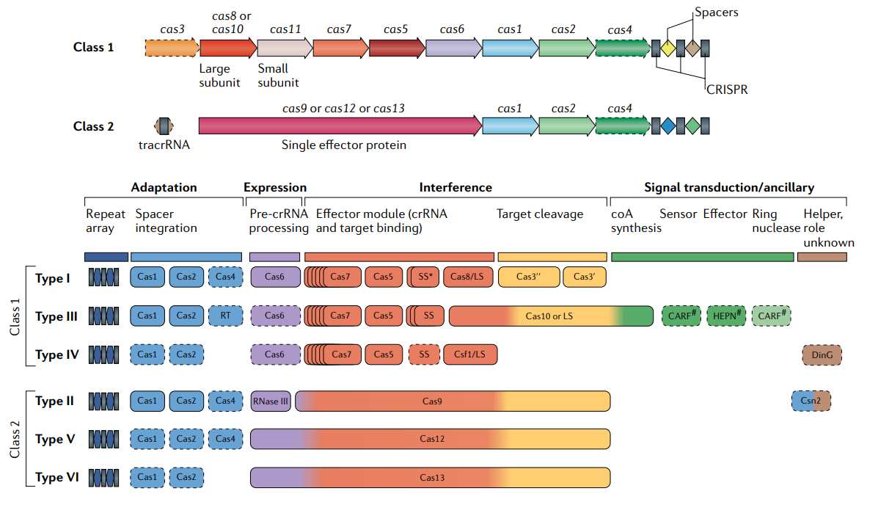
Natural diversity of CRISPR/Cas systems in bacterial genomes:

Slide 32
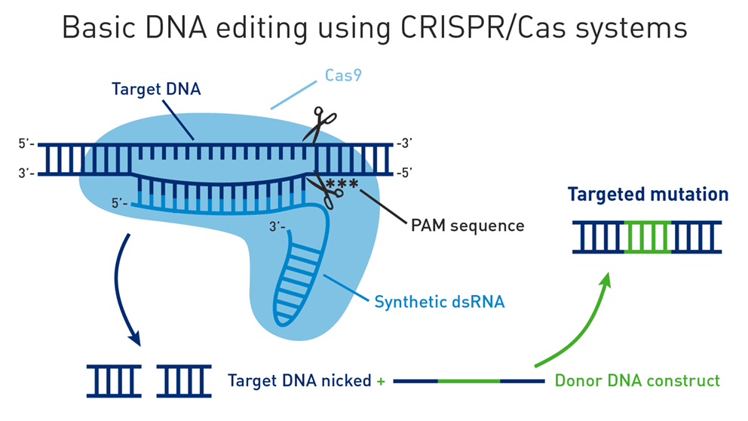
CRISPR/Cas9: A new tool for Genome editing
Notes:
Less than a decade ago, the molecular mechanism of CRISPR/Cas systems were investigated by Doudna and Charpentier’s labs. We already have many R&D lines of CRISPR plants in usage. It is a very effective technology and it really is quite simple, elegant, and effective. The major components are an enzyme called Cas9 and a short RNA called the guideRNA or gRNA. There are a lot of similarities between CRISPR and RNAi mechanisms. Here, the Cas9 enzyme is loaded with a guide RNA. The 5’ end of this guide RNA determines the specificity. Cas9 is a nuclease that degrades double stranded DNA. It will go along DNA until it finds a region that matches the guide RNA. And it will cleave both ends of the DNA introducing a double stranded break. This will be repaired by the Doublestranded break repair mechanisms of the cell. This might create small insertions/deletions. If there is a donor piece of DNA that has homology on the ends to your cut, the cell will use a homologous recombination repair mechanism that fixes the break by inserting the new DNA.

Slide 33
CRISPR You can design a gRNA to cleave nearly anywhere in a genome
Steps:
Identify the target DNA you want to mutate (e.g. eBSV gene)
DNAse
Notes:
So how do you CRISPR plants? First, you ID a gene that you want to mutate. E.g. removing the effector binding element from a Xanthomonas susceptibility gene. Next is a grad school level detail. You need to find a region in your target that is called the PAM. This happens to be any base and then two Guanines. The Cas9 enzyme cleaves at the PAM. GGs are very common, so you can mutate almost any region in a genome. Next you design a guide RNA that binds next to this PAM region. Then you transiently express both the guideRNA and your Cas9 in a plant callus using Agrobacterium or another method. The Cas9 will cut the DNA in the callus. But the Cas9 won’t be part of the plant genome forever. You can then screen the regenerated plants for one that has the desired mutation but lacks cas9.

Slide 34
CRISPR You can design a gRNA to cleave nearly anywhere in a genome
Steps:
Identify the target DNA you want to mutate (e.g. eBSV gene)
Find a “PAM” in the gene i.e. a pair of “GG” dinucleotides
DNAse
=NGG*
Notes:
So how do you CRISPR plants? First, you ID a gene that you want to mutate. E.g. removing the effector binding element from a Xanthomonas susceptibility gene. Next is a grad school level detail. You need to find a region in your target that is called the PAM. This happens to be any base and then two Guanines. The Cas9 enzyme cleaves at the PAM. GGs are very common, so you can mutate almost any region in a genome. Next you design a guide RNA that binds next to this PAM region. Then you transiently express both the guideRNA and your Cas9 in a plant callus using Agrobacterium or another method. The Cas9 will cut the DNA in the callus. But the Cas9 won’t be part of the plant genome forever. You can then screen the regenerated plants for one that has the desired mutation but lacks cas9.

Slide 35
CRISPR You can design a gRNA to cleave nearly anywhere in a genome
Steps:
Identify the target DNA you want to mutate (e.g. eBSV gene)
Find a “PAM” in the gene i.e. a pair of “GG” dinucleotides
Design a guideRNA (gRNA) that basepairs next to the PAM.
DNAse
=NGG*
Guide RNA
(gRNA)
3.
Notes:
So how do you CRISPR plants? First, you ID a gene that you want to mutate. E.g. removing the effector binding element from a Xanthomonas susceptibility gene. Next is a grad school level detail. You need to find a region in your target that is called the PAM. This happens to be any base and then two Guanines. The Cas9 enzyme cleaves at the PAM. GGs are very common, so you can mutate almost any region in a genome. Next you design a guide RNA that binds next to this PAM region. Then you transiently express both the guideRNA and your Cas9 in a plant callus using Agrobacterium or another method. The Cas9 will cut the DNA in the callus. But the Cas9 won’t be part of the plant genome forever. You can then screen the regenerated plants for one that has the desired mutation but lacks cas9.

Slide 36
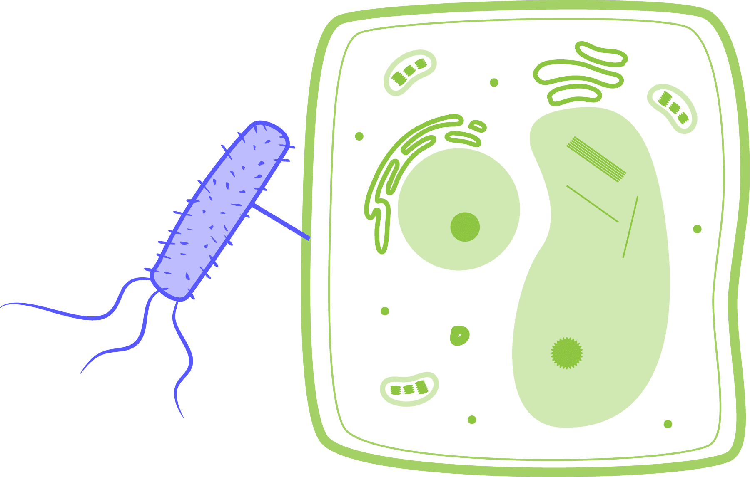
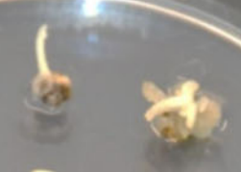
CRISPR You can design a gRNA to cleave nearly anywhere in a genome
Cas9 DNase
Steps:
Identify the target DNA you want to mutate (e.g. eBSV gene)
Find a “PAM” in the gene i.e. a pair of “GG” dinucleotides
Design a guideRNA (gRNA) that basepairs next to the PAM.
Use Agrobacterium to transiently express the gRNA and cas9 gene in the plant tissue.
=NGG*
Guide RNA
(gRNA)
Agrobacterium
cas9
gRNA
promoter
promoter
Notes:
So how do you CRISPR plants? First, you ID a gene that you want to mutate. E.g. removing the effector binding element from a Xanthomonas susceptibility gene. Next is a grad school level detail. You need to find a region in your target that is called the PAM. This happens to be any base and then two Guanines. The Cas9 enzyme cleaves at the PAM. GGs are very common, so you can mutate almost any region in a genome. Next you design a guide RNA that binds next to this PAM region. Then you transiently express both the guideRNA and your Cas9 in a plant callus using Agrobacterium or another method. The Cas9 will cut the DNA in the callus. But the Cas9 won’t be part of the plant genome forever. You can then screen the regenerated plants for one that has the desired mutation but lacks cas9.

Slide 37
CRISPR You can design a gRNA to cleave nearly anywhere in a genome
Cas9 DNase
Steps:
Identify the target DNA you want to mutate (e.g. eBSV gene)
Find a “PAM” in the gene i.e. a pair of “GG” dinucleotides
Design a guideRNA (gRNA) that basepairs next to the PAM.
Use Agrobacterium to transiently express the gRNA and cas9 gene in the plant tissue. Cas9 will bind the gRNA and cleave where the gRNA binds DNA
=NGG*
Guide RNA
(gRNA)
Agrobacterium
cas9
gRNA
promoter
promoter
Notes:
So how do you CRISPR plants? First, you ID a gene that you want to mutate. E.g. removing the effector binding element from a Xanthomonas susceptibility gene. Next is a grad school level detail. You need to find a region in your target that is called the PAM. This happens to be any base and then two Guanines. The Cas9 enzyme cleaves at the PAM. GGs are very common, so you can mutate almost any region in a genome. Next you design a guide RNA that binds next to this PAM region. Then you transiently express both the guideRNA and your Cas9 in a plant callus using Agrobacterium or another method. The Cas9 will cut the DNA in the callus. But the Cas9 won’t be part of the plant genome forever. You can then screen the regenerated plants for one that has the desired mutation but lacks cas9.

Slide 38
CRISPR You can design a gRNA to cleave nearly anywhere in a genome
Cas9 DNase
Steps:
Identify the target DNA you want to mutate (e.g. eBSV gene)
Find a “PAM” in the gene i.e. a pair of “GG” dinucleotides
Design a guideRNA (gRNA) that basepairs next to the PAM.
Use Agrobacterium to transiently express the gRNA and cas9 gene in the plant tissue. Cas9 will bind the gRNA and cleave where the gRNA binds DNA
Regenerate plants. Screen for desired mutation & lack of cas9 gene.
=NGG*
Guide RNA
(gRNA)
Agrobacterium
cas9
gRNA
promoter
promoter
Notes:
So how do you CRISPR plants? First, you ID a gene that you want to mutate. E.g. removing the effector binding element from a Xanthomonas susceptibility gene. Next is a grad school level detail. You need to find a region in your target that is called the PAM. This happens to be any base and then two Guanines. The Cas9 enzyme cleaves at the PAM. GGs are very common, so you can mutate almost any region in a genome. Next you design a guide RNA that binds next to this PAM region. Then you transiently express both the guideRNA and your Cas9 in a plant callus using Agrobacterium or another method. The Cas9 will cut the DNA in the callus. But the Cas9 won’t be part of the plant genome forever. You can then screen the regenerated plants for one that has the desired mutation but lacks cas9.

Slide 39
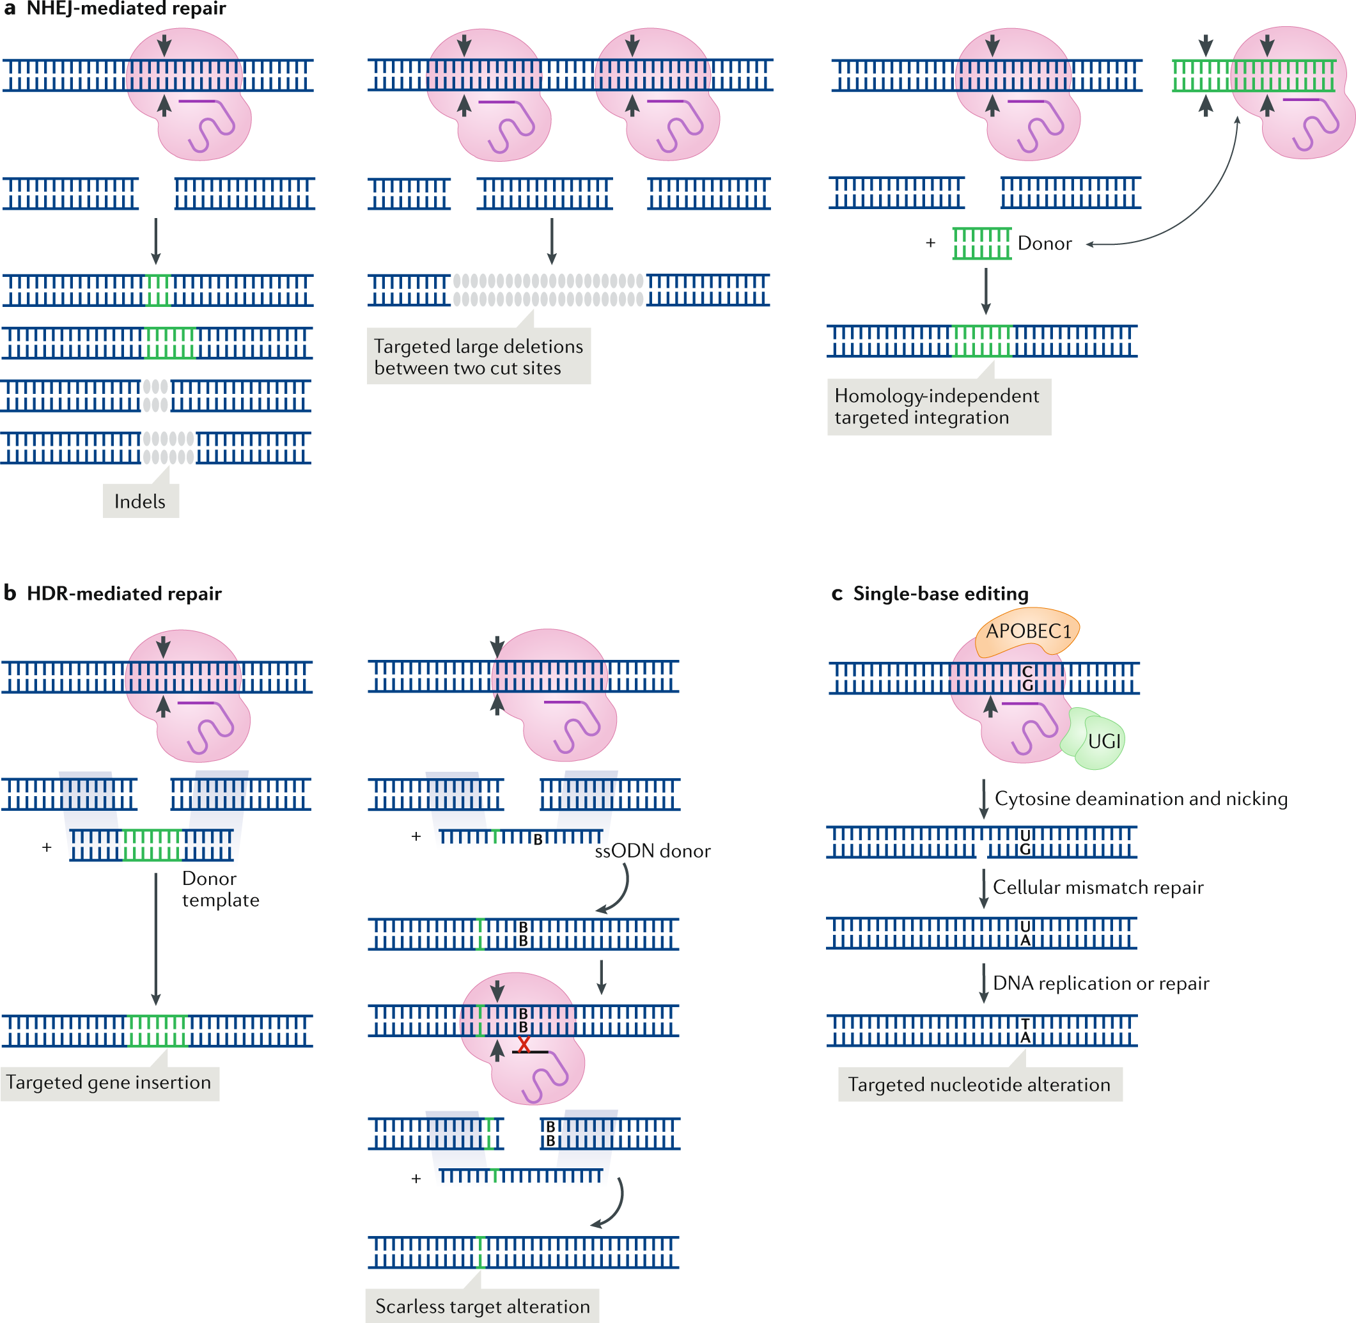
CRISPR can be engineered to target different types of mutations
https://www.nature.com/articles/s41580-019-0131-5
Notes:
https://www.nature.com/articles/s41580-019-0131-5

Slide 40
Major Cas enzymes used in biotech currently
https://www.science.org/doi/full/10.1126/science.aat5011#F1
Notes:
https://www.science.org/doi/full/10.1126/science.aat5011#F1

Slide 41
Use of CRISPR/Cas in pathogen detection
https://doi.org/10.1038/s41587-020-0513-4

Slide 42
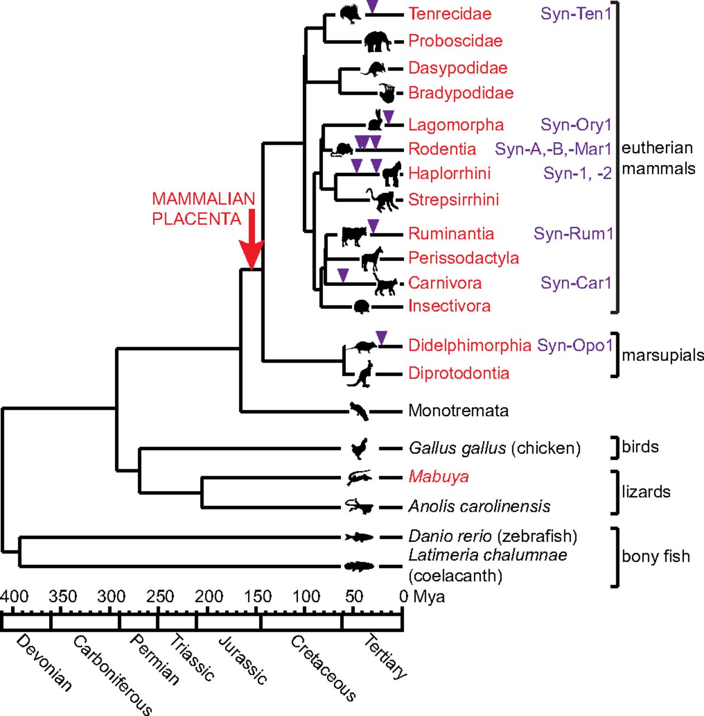
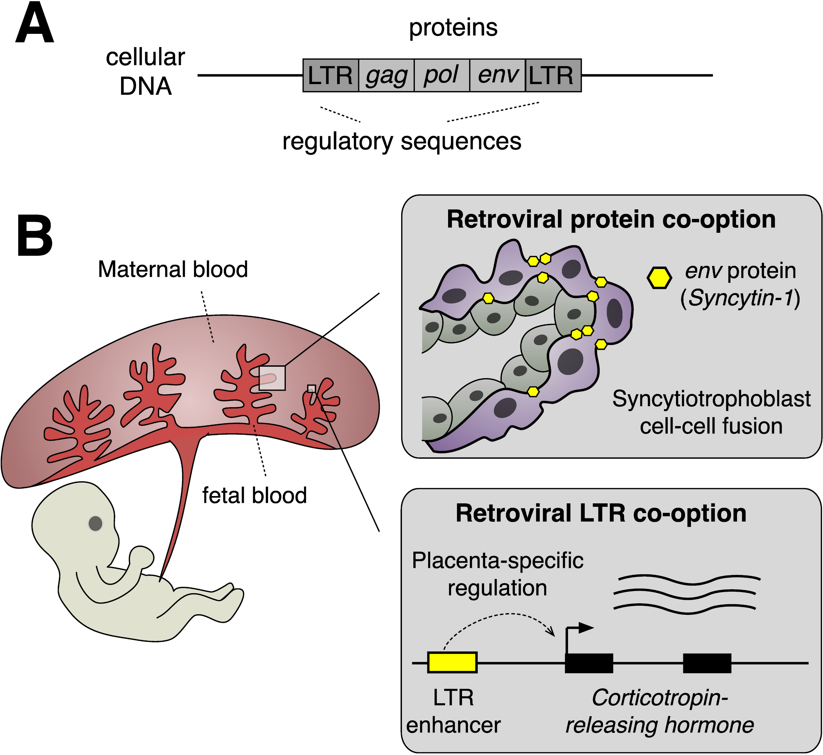
Placentas, Syncytia and Endogenous viruses
https://doi.org/10.1371/journal.pbio.3000028
https://www.pnas.org/content/114/51/E10991

Slide 43
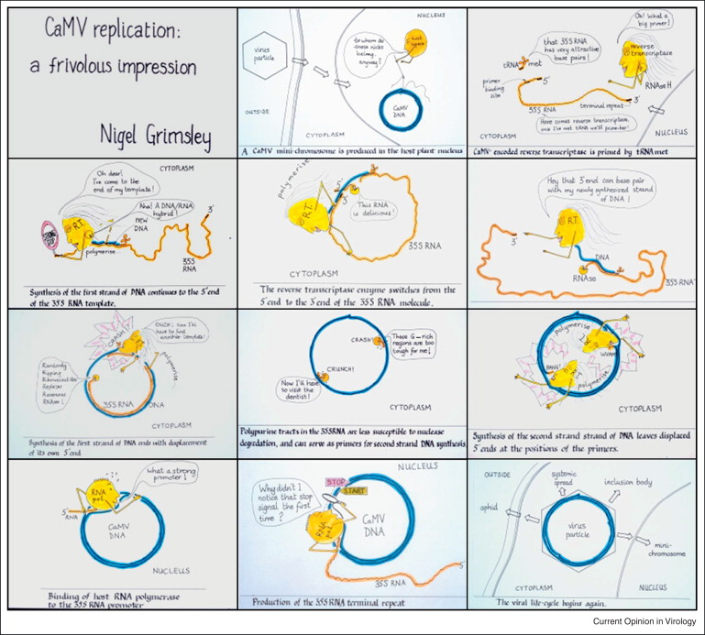

Slide 44
https://www.sciencedirect.com/science/article/pii/S1567134813003857?via%3Dihub

