Slide 1
Xanthomonas spp.

Slide 2
Taxonomy, phylogeny, etc.

Slide 3
Xanthomonas Evolutionary neighborhood
Genus
Class
Phylum
Caulobacter
Alpha (α)
Agrobacterium
Neisseria
Beta (β)
Ralstonia
Burkholderia
Salmonella
Escherichia
Pseudomonas
Xanthomonas
Xylella
Clostridium
Firmicutes
Gram
Positives
Bacillus
Streptomyces
Actinobacteria
Notes:
I always like to know the evolutionary neighborhood of microbes. Ralstonia is a gram-negative beta-proteobacteria rod. It’s a cousin to Burkholderia which is becoming an emerging infectious disease of humans.

Slide 4
Evolutionary Neighborhood
Remember: the Xanthomonas genus is polyphyletic. This means that some of the Xanthomonas species are likely to be renamed in the future.
Xanthomonas
*As of Fall 2021…

Slide 5
Genome Reduction in Xanthomonas

Slide 6
Xanthomonas strains have switched tissue tropism repeatedly during their evolutionary histories
Tissue
Key:

Slide 7
Disease Biology

Slide 8
Foliar pathogenesis: Life on & in a leaf

Slide 9
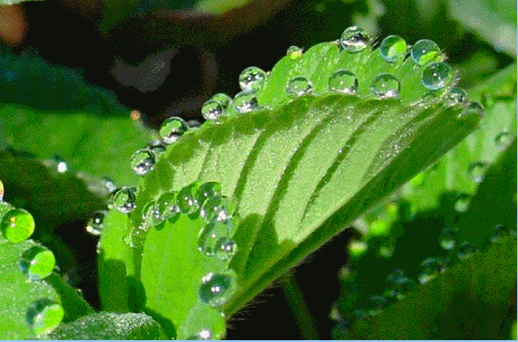
Additional visuals/jargon about leaf anatomy
Epiphytic bacteria colonize the surfaces
(phyllosphere, rhizosphere, etc)
Apoplast
Endophytic bacteria colonize the inside: apoplast, xylem, phloem, and/or root cortex
Open/close to regulate CO₂ uptake/H₂O loss.
If xylem pressure is too strong, hydathodes act as “pressure valves” and release fluid as

Slide 10
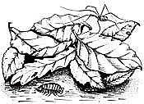
nonvascular Xanthomonas strains: Life cycle
via wound
via stomata

Slide 11
vascular Xanthomonas strains: Life cycle
via hydathodes
via wound

Slide 12
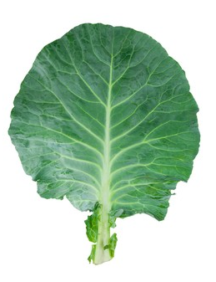
Xanthomonas: Two patterns of foliar tissue tropism
Tissue tropism is a phenomenon by which certain host tissues preferentially support the growth and proliferation of pathogens.
Local or systemic?
Entry point
Tissue preferences
Types of symptoms/ diseases

Slide 13
Management

Slide 14
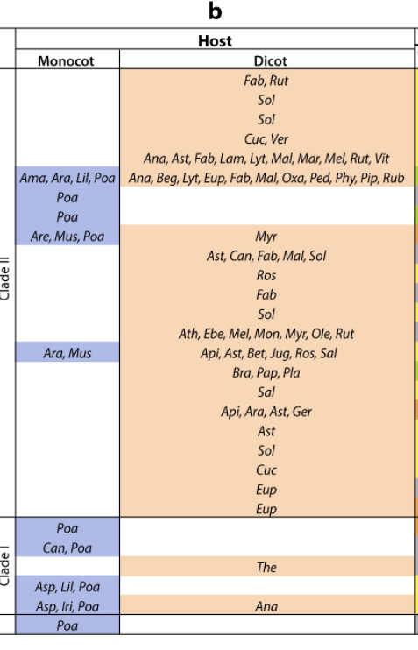
Xanthomonas host ranges
Tissue
Host range of the genus:
Host range of each strain:

Slide 15
Xanthomonas host ranges
Tissue
1
2
3
3
4
5
6
7
8
9
10
2
5
8
11
1
12
9
13
7
3
1
3
Host range key:
Monocots: Ama, Amatyllidaceae; Ara, Araceae; Are, Arecaceae; Asp, Asparagaceae; Can, Cannaceae; Iri,
Iridaceae; Lil, Liliaceae; Mus, Musaceae; Poa, Poaceae.
Dicots: Ana, Anacardiaceae; Api, Apiaceae; Ara, Araliceae; Ast, Asteraceae; Ath,
Atherospermataceae; Beg, Begoniaceae; Bet, Betulaceae; Bra, Brassicaceae; Can, Cannabaceae; Cuc, Cucurbitaceae; Ebe, Ebenaceae; Eup,
Euphorbiaceae; Fab, Fabaceae; Ger, Geraniaceae; Jug, Juglandaceae; Lam, Lamiaceae; Lyt, Lythraceae; Mal, Malvaceae; Mar, Martyniaceae;
Mel, Meliaceae; Mon, Monimiaceae; Myr, Myrtaceae; Ole, Oleaceae; Oxa, Oxalidaceae; Pap, Papaveraceae; Ped, Pedaliaceae; Phy, Phyllanthaceae;
Pip, Piperaceae; Pla, Plantaginaceae; Ros, Rosaceae; Rub, Rubiaceae; Rut, Rutaceae; Sal, Salicaceae; Sol, Solanaceae; The, Theaceae; Ver,
Verbenaceae; Vit, Vitaceae.
10
12
2
14
13
15
15
14
6
6
3
4
11
11
5

Slide 16
A few Xanthomonas outbreaks
Citrus canker disease (Non-vascular)
Became endemic in Florida
Was an eradication target in Florida. Not widespread. 2004 hurricane season (4 hurricanes: Ivan, Jeane, Frances, and Charley) tossed it all over the state, so USDA eradication efforts were cancelled in 2006. Managed with copper and Streptomycin (antibiotic) sprays
Banana Xanthomonas wilt (Vascular)
Became epidemic in Central & East Africa
BXW emanated in Uganda in 2001. It affects all banana cultivars, including dessert and cooking bananas and ensete which is grown for it’s starchy tubers. Central and East Africa including banana growing regions of: Rwanda, Democratic Republic of the Congo, Tanzania, Kenya, Burundi, and Uganda.
Bacterial leaf streak of cereals (Vascular)
Epidemic in N. Midwest N. America
It’s a major limitation to wheat and barley breeding, more than the production. Like several of the Xanthomonas, X. translucens can be seed transmitted. For agronomic reasons, wheat breeding is international between N. Am and New Zealand. Contaminated seed cannot be imported to New Zealand, which is a large constraint on the breeding programs.

Slide 17
What is Xanthan Gum?

Slide 18
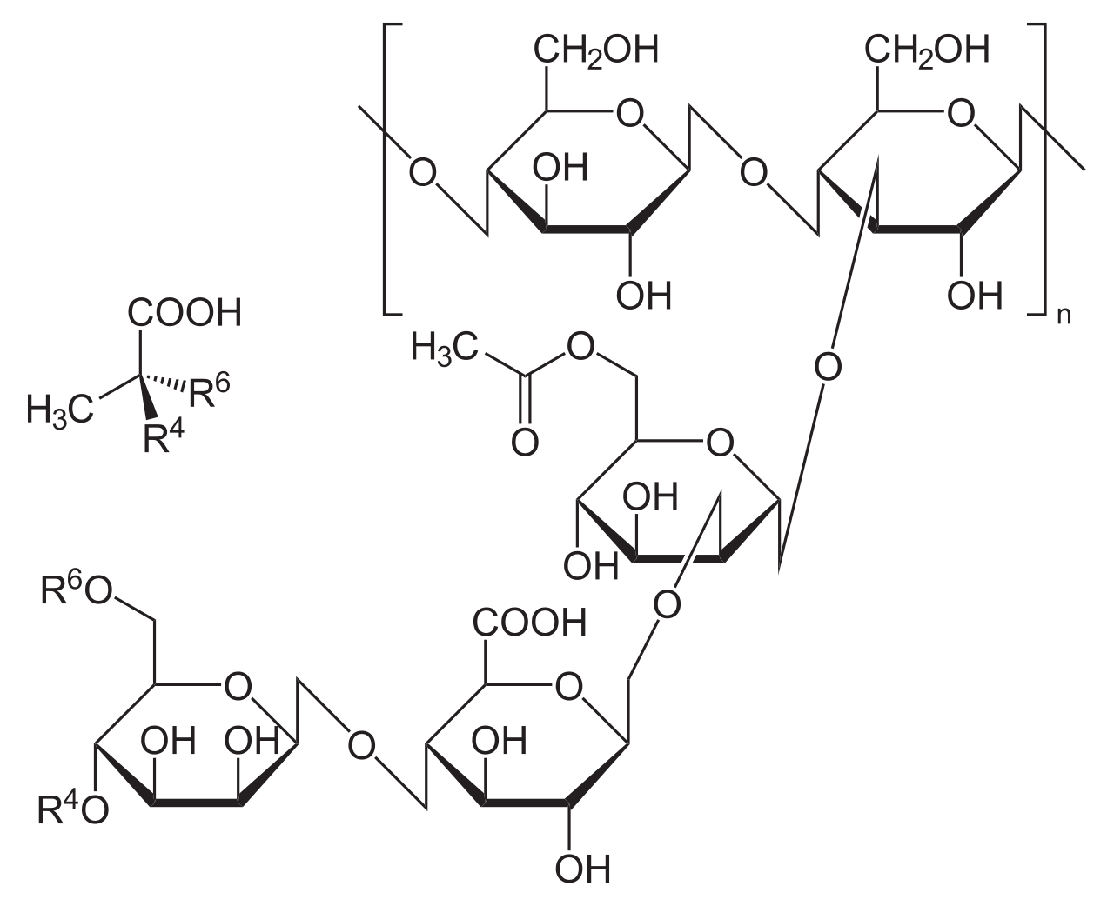

Slide 19
Quorum sensing

Slide 20
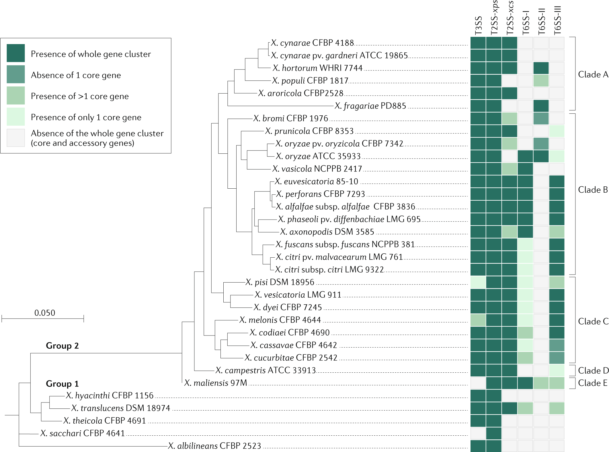
Bacterial weapons: type III secretion system (T3SS) A tool for molecular espionage

Slide 21
Many Xanthomonas use their T3SS to increase nutrient availability
Phloem
Mesophyll cells
Notes:
Okay, I am going to introduce you to a susceptibility gene that increases susceptibility of plants to some Xanthomonas bacteria. The susceptibility genes are SWEET genes, which encode sucrose transport proteins. In a healthy plant, these proteins are expressed near the phloem and direct sucrose to move from the leaf mesophyll into the phloem. The SWEET transporters are shown in red. Some xanthomonas have effectors that manipulate SWEET genes. The bacteria force the plant to increase transcription of SWEET genes, which leads to more SWEET proteins that transport sucrose into the area around the Xanthomonas bacteria. How does this happen? Specifically, Xanthomonas have a lot of effectors that are known as TALs. TAL stands for transcriptional activator like because they have a domain that resembles eukaryotic proteins that recruit RNA polymerase and induce transcription. The TAL effectors bind to specific regions of DNA, recruit RNA polymerase, and recruit RNA polymerase to transcribe genes. S

Slide 22
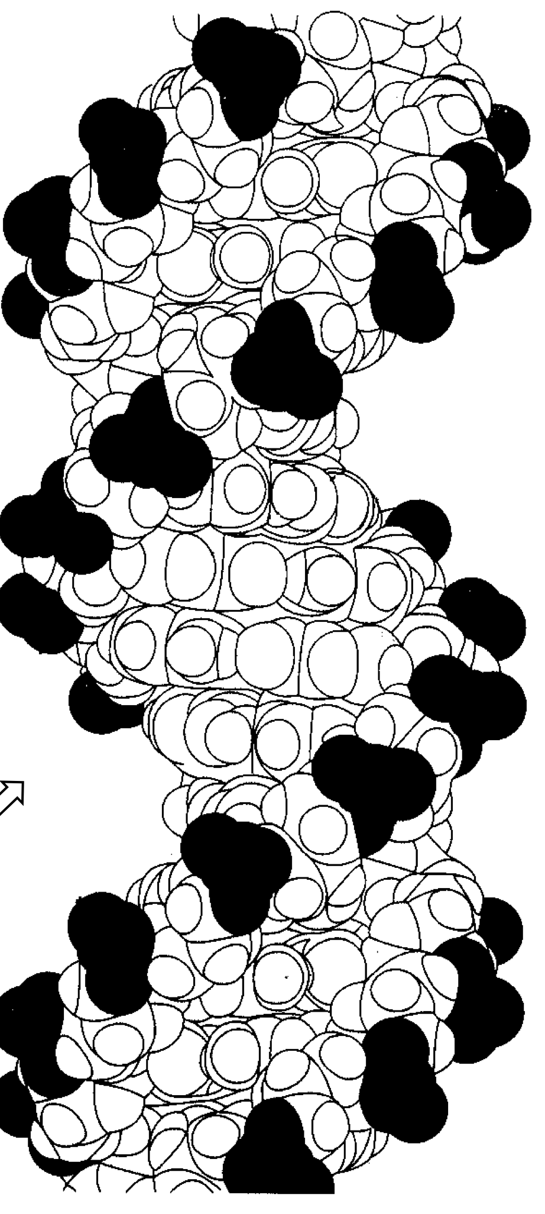
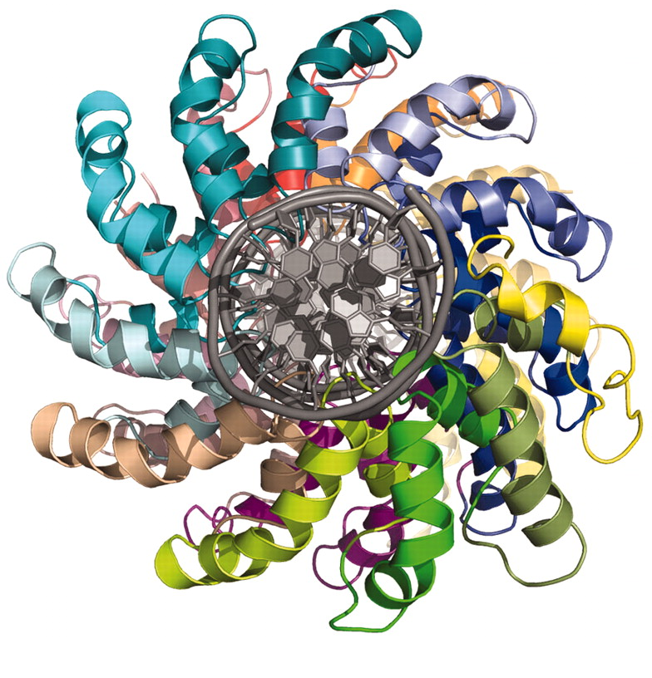
Xanthomonas: TAL effectors
Protein sequence of a TAL:
Type 3 secretion signal
Repeat region
Nuclear localization signals
Transcriptional activation domain
DOI: 10.1126/science.1216211

Slide 23
Xanthomonas: TAL effectors
Target gene
DOI: 10.1126/science.1216211

Slide 24
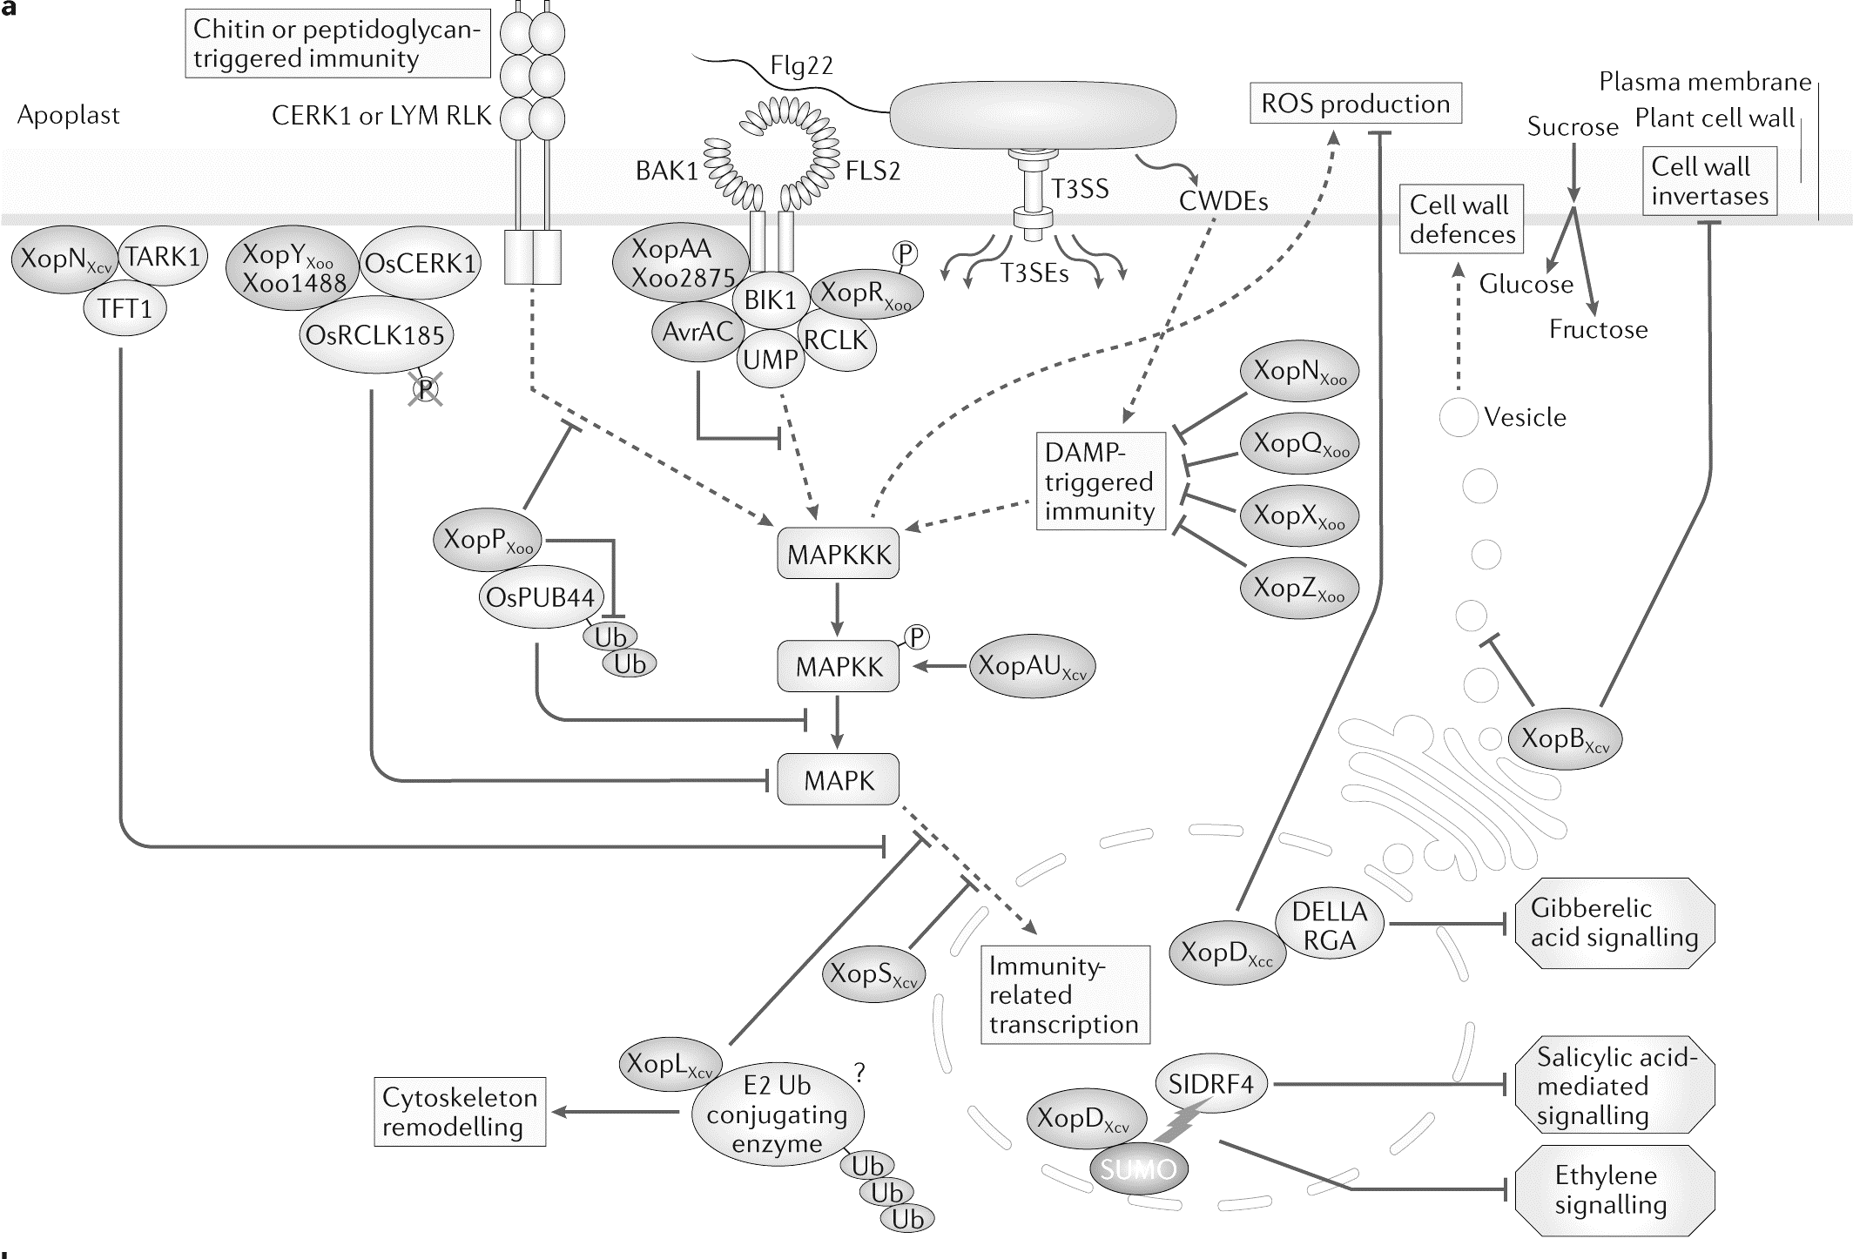

Slide 25
Plant defenses eliminate pathogen and/or prevent it from growing.
Plant immunity kills bacteria
Bacteria survive
Pathogens in a non-host
Adapted pathogens in a compatible host
Tolerant host
Pathogen populations low

Slide 26
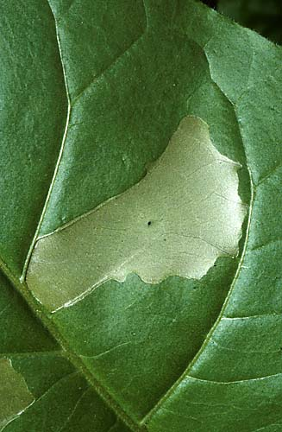
Plant immunity kills bacteria
Bacteria survive

Slide 27
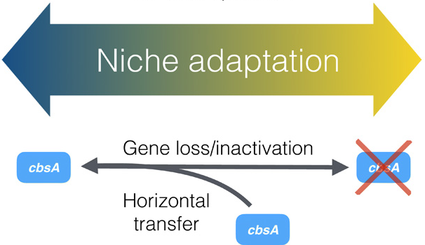
genE
genE
genE

Slide 28
Bacterial weapons: type 2 secretion system (T2SS) A tool for environmental manipulation

Slide 29
Bacterial weapons: type 2 secretion system (T2SS) A tool for environmental manipulation

Slide 30
Please read the paper’s title.
Is any jargon unclear?
What will we learn about from this paper?

Slide 31
Please read the Abstract.
Is any jargon unclear?
What will we learn about from this paper?

Slide 32
Pillars of Evolution:
Mutation
Horizontal gene transfer
Genetic Drift
Selection
Dispersal

Slide 33
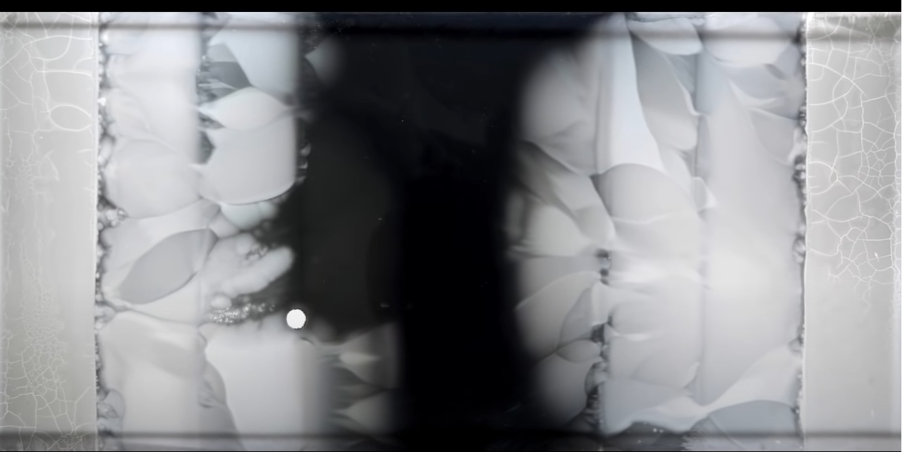
Baym et al. 2016 PMID: 27609891

Slide 34
Bacterial Evolution Demonstration: Mega Plate Experiment
https://www.youtube.com/watch?v=plVk4NVIUh8&ab_channel=HarvardMedicalSchool
Mega Plate:
Step-wise increase in antibiotic concentration
There needs to be a large enough population to generate mutants (genetic variation), and a small enough barrier so mutants can overcome it.
Baym et al. 2016 PMID: 27609891

