Slide 1
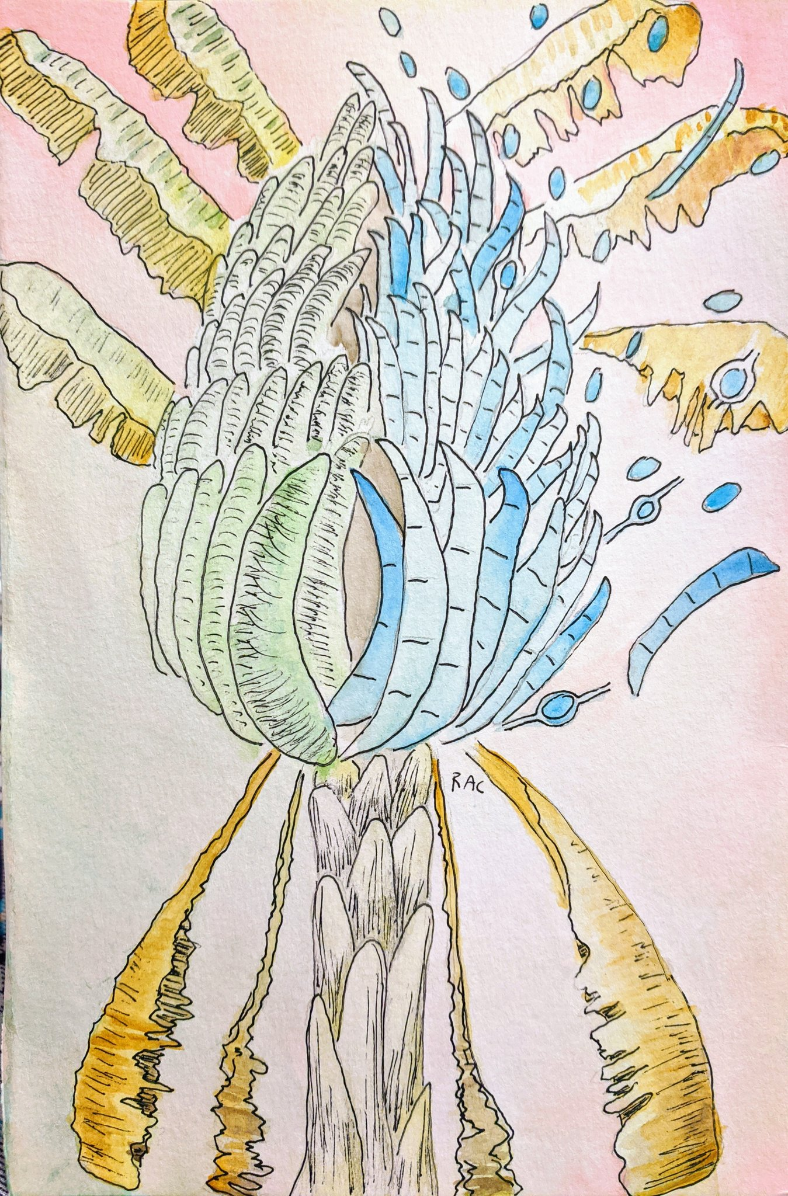
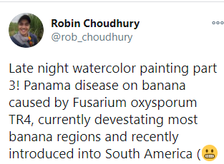
Fusarium graminearum
a Cereal Killer

Slide 2
Taxonomy, phylogeny, etc.

Slide 3
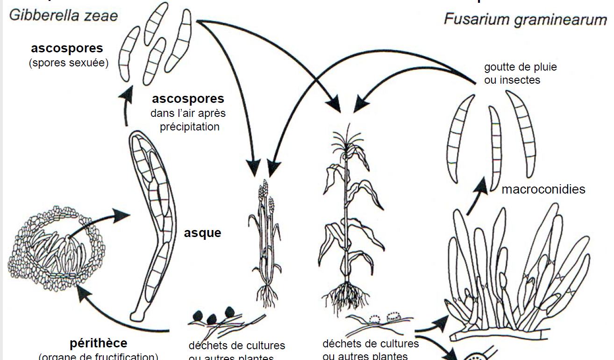
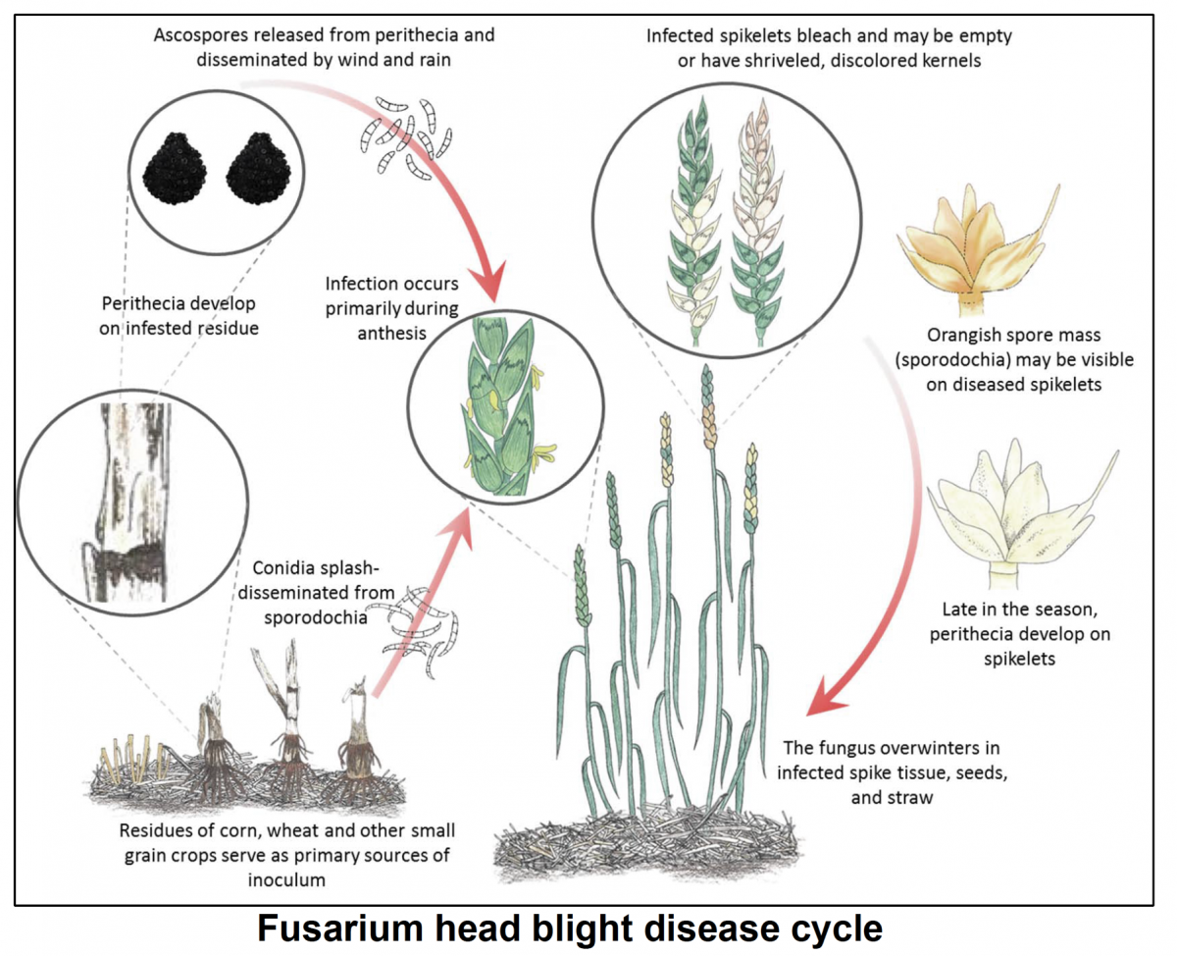
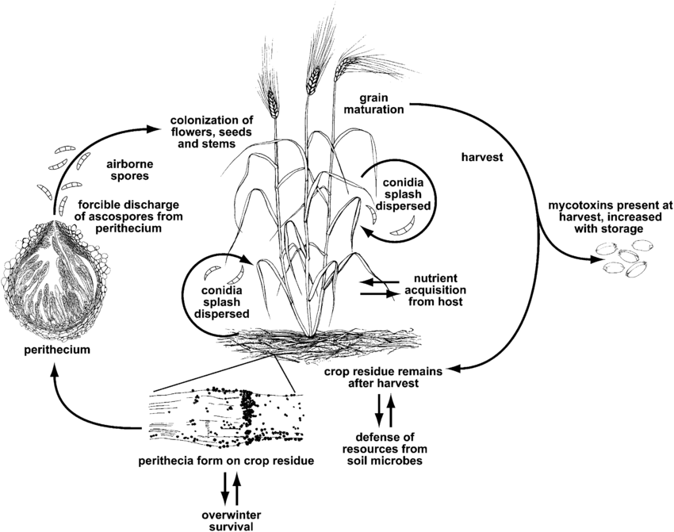
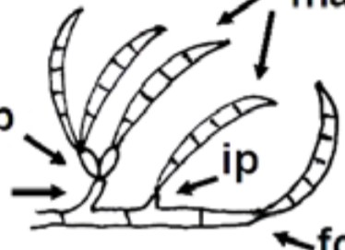
Because fungi were named at their sexual reproduction stage, many ascomycetes with sexual and asexual reproduction were given 2 names. Fusarium graminearum was also known as Gibberella zeae.
2013: “One fungus, One name” – move to give one species name to all fungi.
As far as I understand, the Giberella genus is defunct & refers to Fusarium sp…
Gibberella zeae
Fusarium graminearum
Sexual
cycle
Asexual
cycle

Slide 4
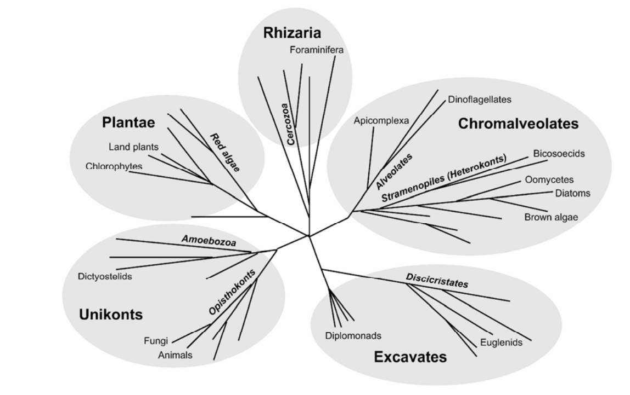
Evolutionary
Neighborhood

Slide 5
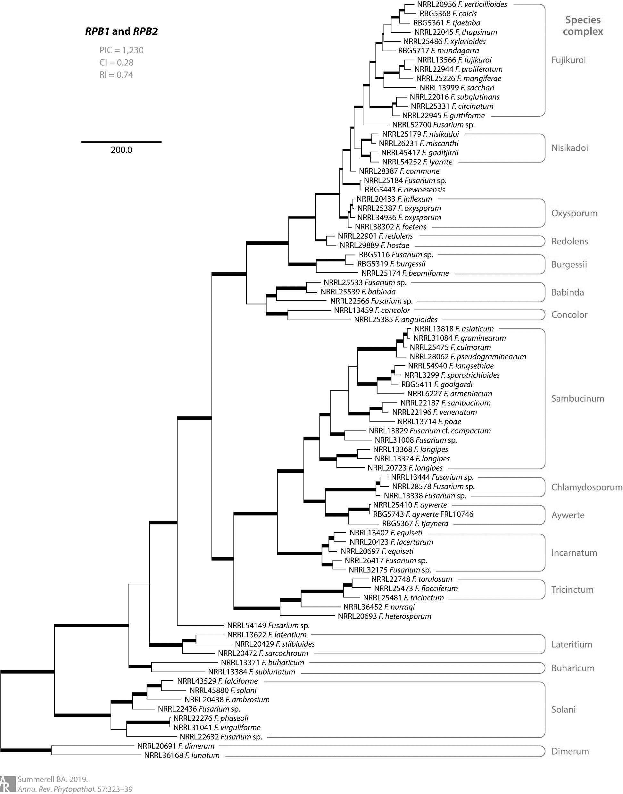
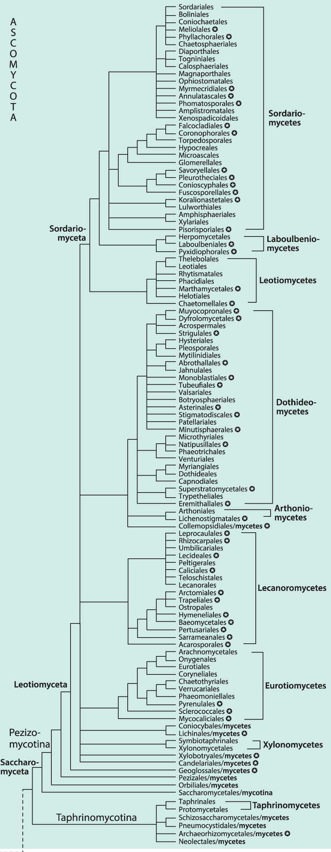
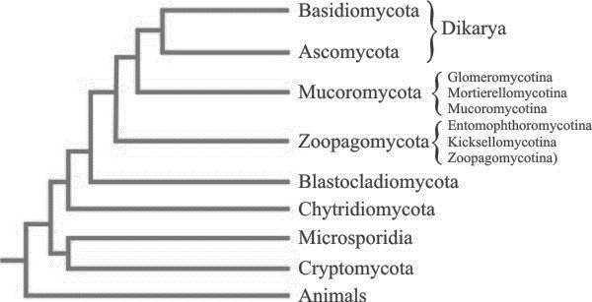
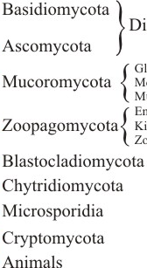
Evolutionary
Neighborhood
Sordariomycetes (Class)
Hypocreales
(order)

Slide 6
Other important Fusarium species
Fusarium oxysporum species complex (FOSC)
Famous epidemics:

Slide 7
Disease Biology

Slide 8
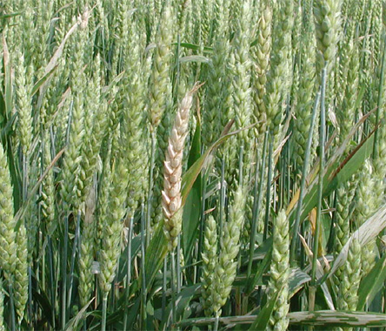
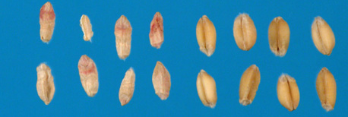
Fusarium head blight

Slide 9
Life Cycle: Fusarium graminearum
The majority of the isolates of F. graminearum are homothallic, meaning that they are able to sexually reproduce without a partner.
But they can “out-cross” with compatible partners.

Slide 10
Fusarium head blight: Infection
Fusarium graminearum

Slide 11
Fusarium head blight: in planta growth

Slide 12
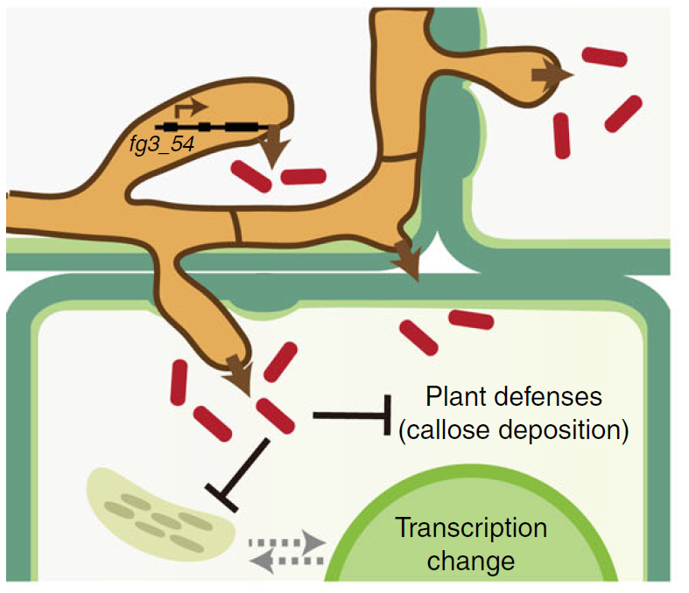

Fusarium head blight: in planta growth

Slide 13
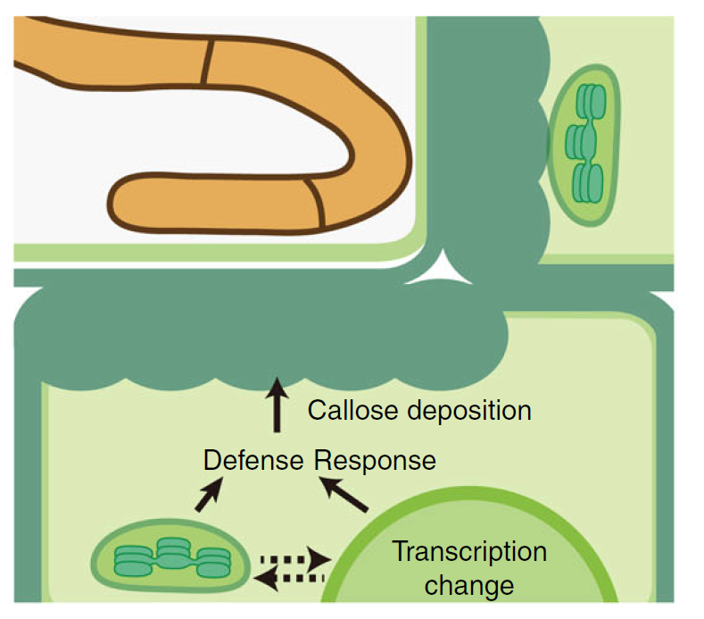
Plant defenses to filamentous pathogens

Slide 14
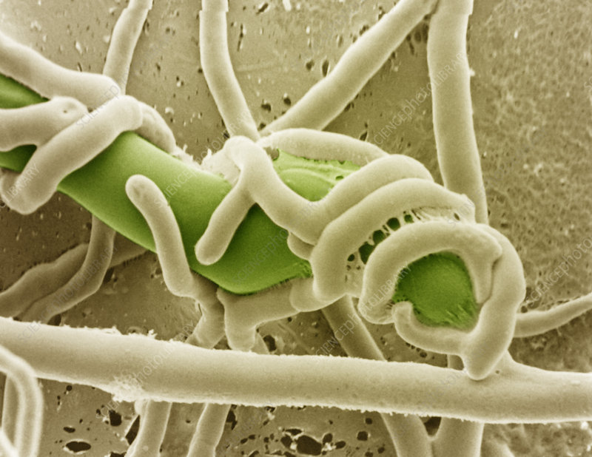
Role secondary metabolites in Saprophytic phase

Slide 15
Fg weapons: Secondary metabolites
Fg genomes contain 67 putative secondary metabolite gene clusters, including:
7
15
19

Slide 16
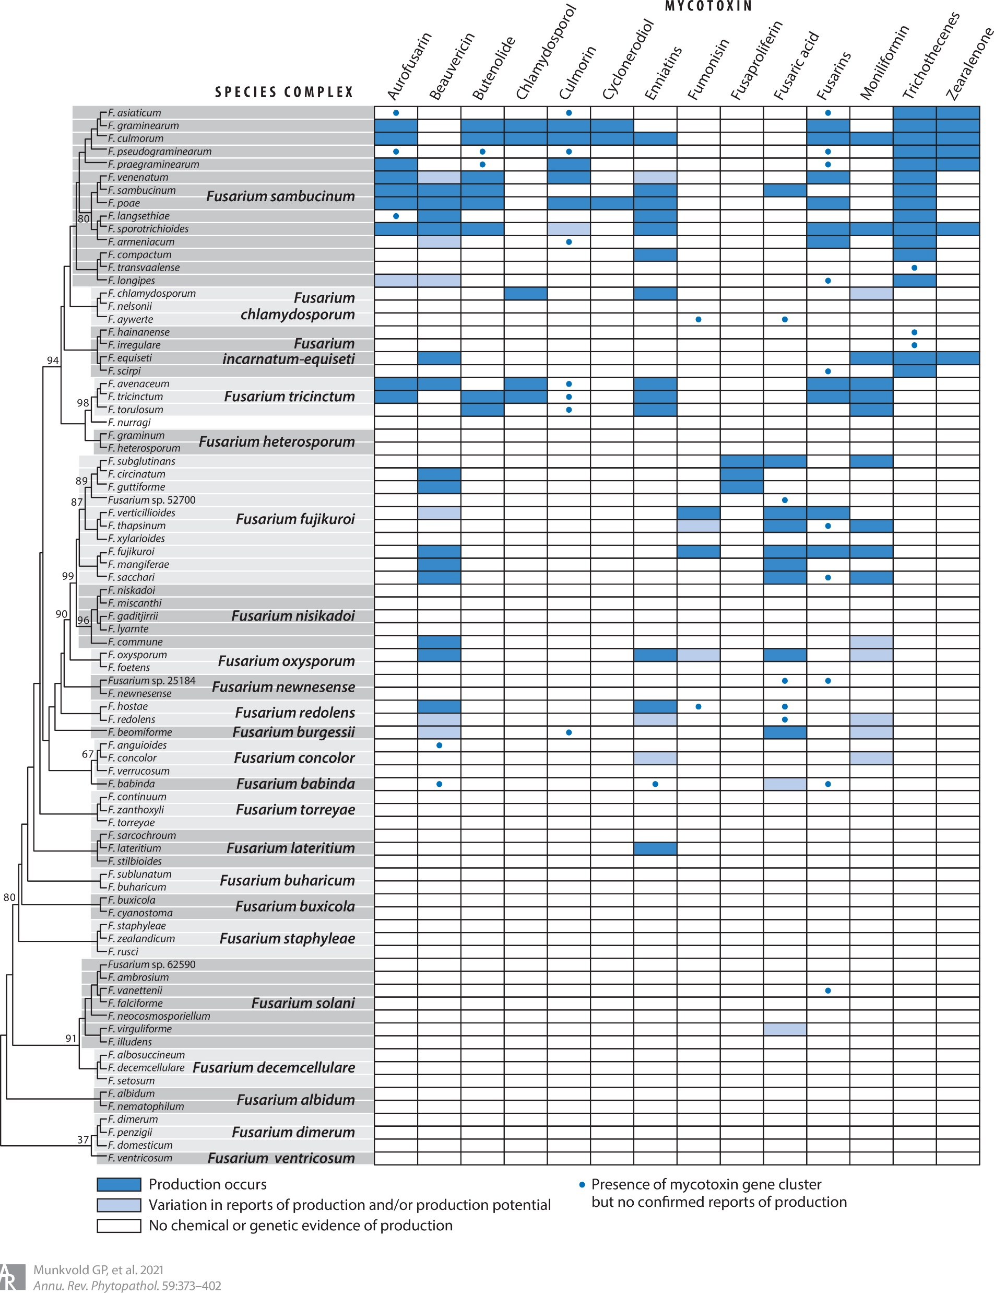
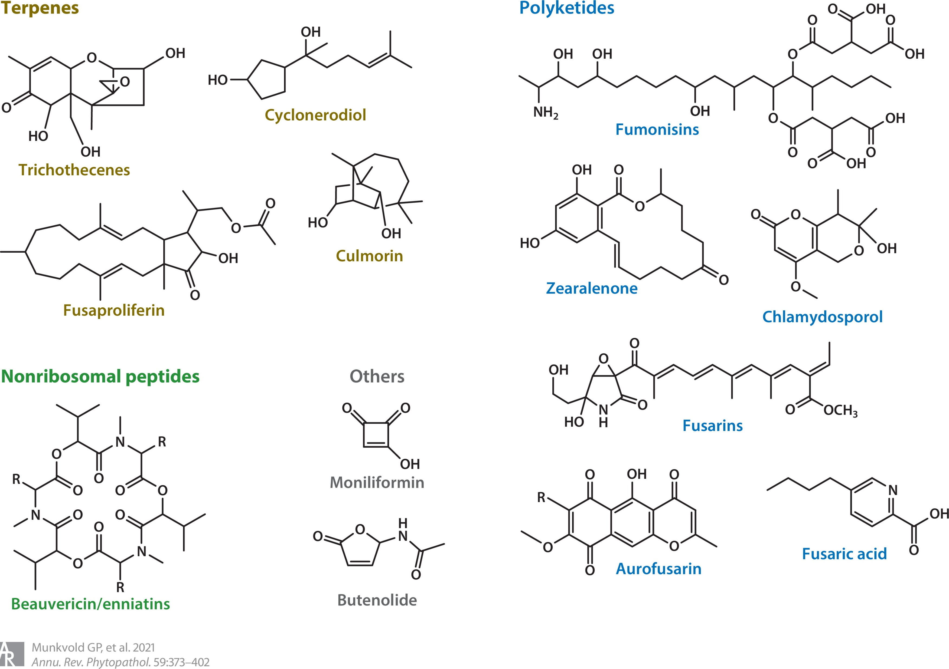
Terpenes
Cyclonerodiol
Culmorin

Slide 17
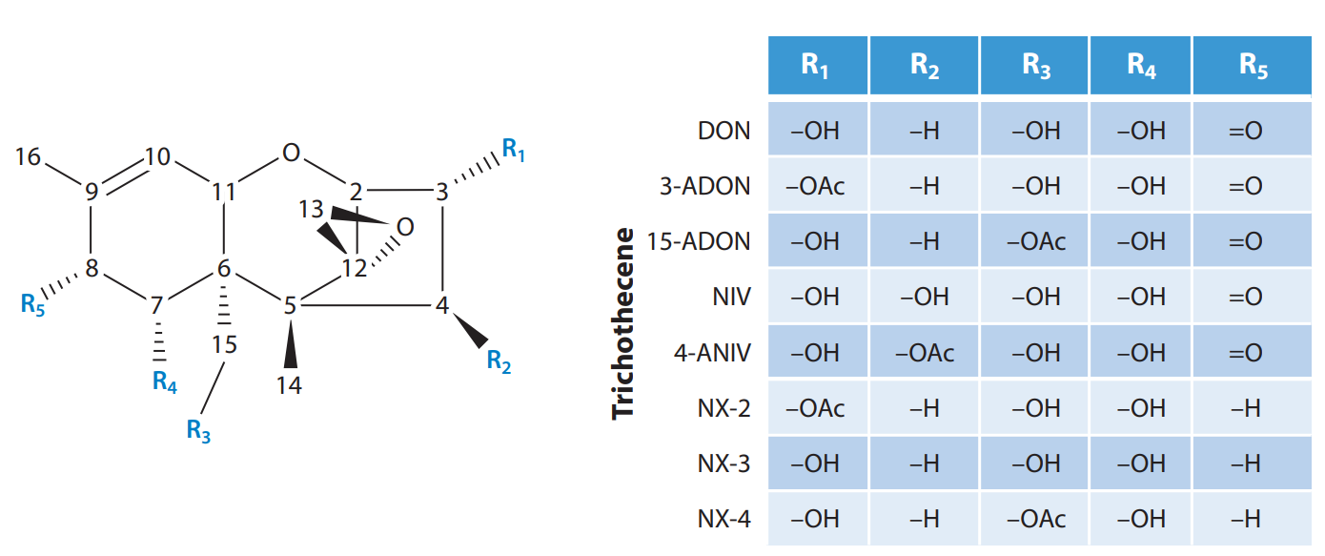
Fg weapons: Trichothecenes
Symptoms in animals:
Acute:
Chronic:
Chemical properties:
Mode of action:

Slide 18
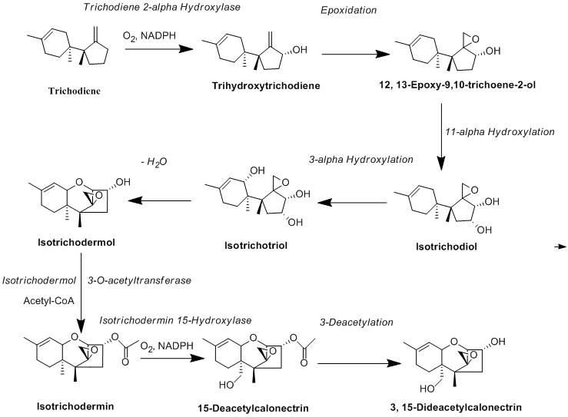
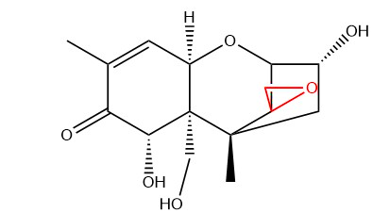
Biosynthesis of Trichothecenes (e.g.DON)
Cyclization
Hydroxylation
Oxidation

Slide 19
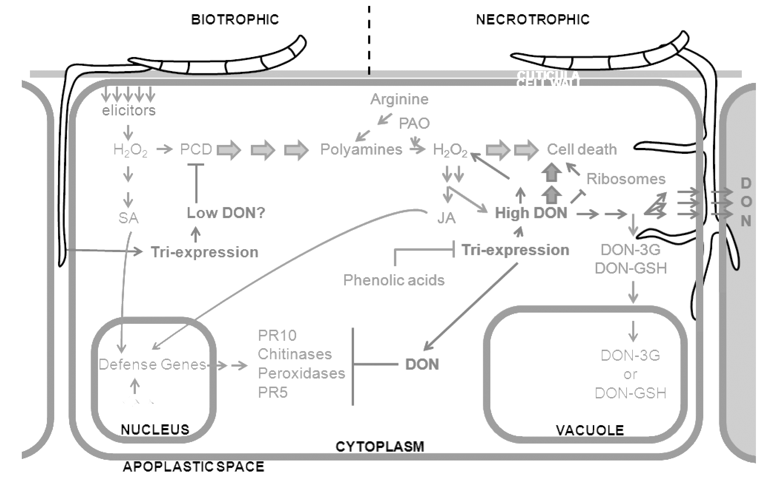


Role of Trichothecenes in plant infection
Early infection
Late infection:
Plant cell

Slide 20
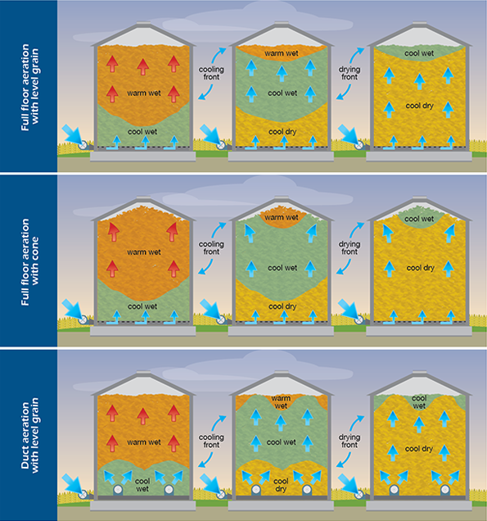
Post-harvest / storage & Trichothecenes
Grain silos: engineered to be
Conditions that promote:

Slide 21


Polyketides
Zearalenone
Aurofusarin
Chlamydosporol
Fusarin

Slide 22
Nonribosomal peptide synthetases (NRPS)
Peptide synthetases:
Non-ribosomal:
Why?
  -
  -NPRSes can incorporate:
    -
    -
    -

Slide 23
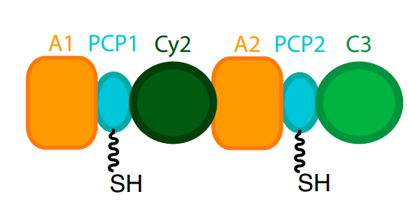
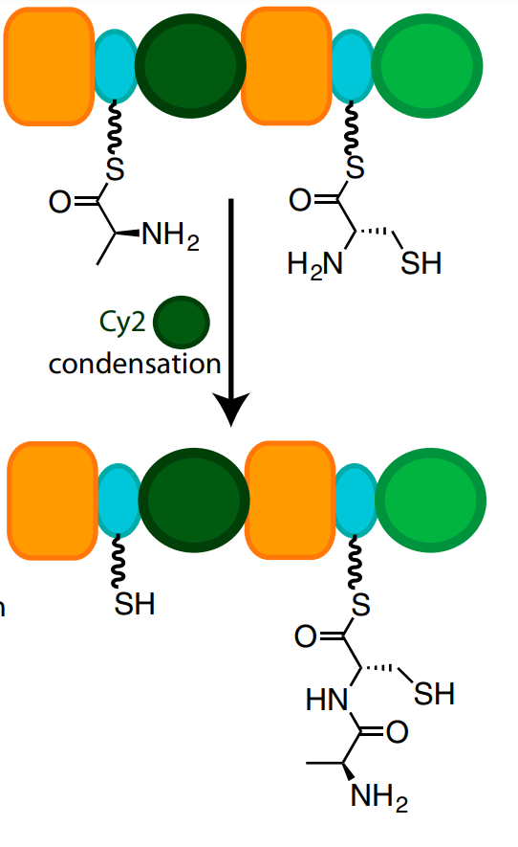
Nonribosomal peptide synthetases (NRPS)
  A:
  PCP:
  C:

Slide 24
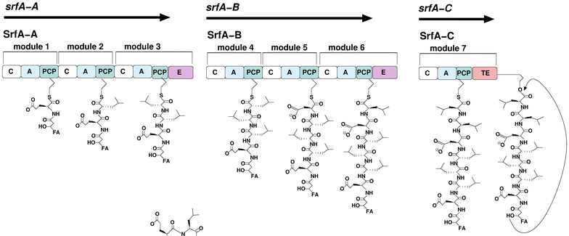
Nonribosomal peptide synthetases (NRPS)

Slide 25
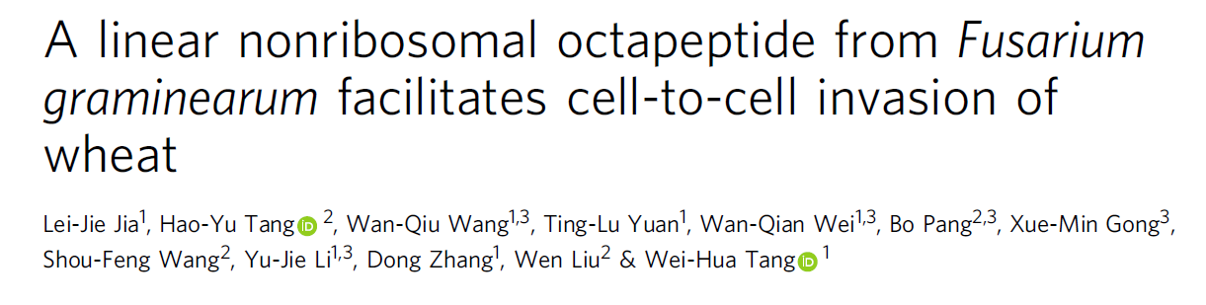
Please read the paper’s title.
Is any jargon unclear?
What will we learn about from this paper?

Slide 26
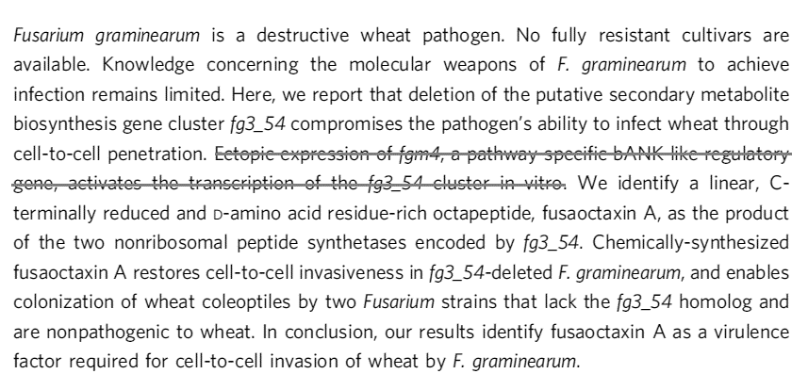
Please read the Abstract.
Take 2 minutes to read the abstract and consider these questions. Then I would like you to share with the class.
Is any jargon unclear?
What will we learn about from this paper?

Slide 27
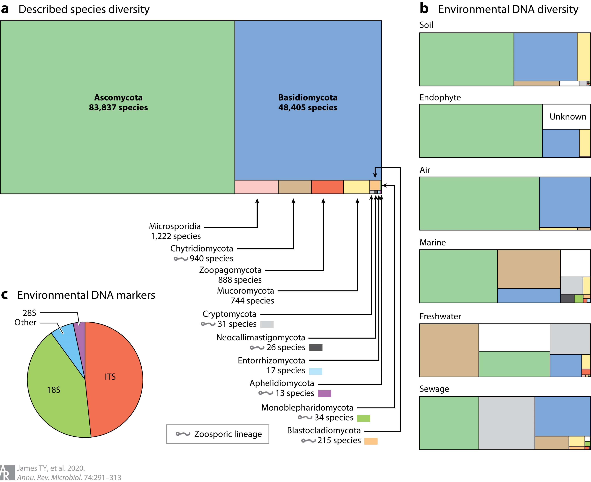
What I learned about fungal diversity while researching this lecture

